Slide 1
Long-term Assets: Tangible and Intangible

Slide 2
Asset-light vs Asset-heavy model
Insufficient
capacity results
in lost sales.
Costly excess
capacity reduces
profits.
How much
is enough?
Source: Financial accounting, Libby, Libby and Hodge, 10th edition, McGraw-Hill Education

Slide 3
Long-term assets – overview
Long-term assets mainly consist of:
Tangible assets - property, plant and equipment (PPE)
Intangible assets – no physical substance – patents, trademarks, goodwill

Slide 4
Long-term assets – examples by industry
Tesla – large balance for manufacturing facilities
Apple – not much as most of the production is outsourced
Hilton - asset-light model - Hilton does not own its hotels
Pfizer – more than 50% of the assets are intangible assets
Salesforce – SaaS business, low need for physical assets
Netflix – mostly content (intangible) assets

Slide 5
Long-term assets – reporting
Long-term fixed assets are recorded as assets (no earnings impact) at acquisition cost:
Purchase price or construction cost
All other changes to bring the asset in use
Long-term improvements
Routine maintenance and repairs are expensed right away – earnings impact.

Slide 6
Depreciation – terminology and process
Depreciation is the process of allocating the cost of long-term tangible assets over their productive life to the income statement as expense.
Terms to know:
Depreciation expense
Accumulated depreciation
Net book value

Slide 7
Depreciation expense
The depreciation expense depends on a few inputs - estimated useful life and the chosen depreciation method.
Depreciation methods:
Straight-line
Declining-balance
Units-of-production

Slide 8
Depreciation – methods
Straight-line – same expense over the asset’s useful life.
Double-declining balance – the expense is higher initially.
Units of production method – based on the actual production compared to estimated total production.
Total depreciation expense over the useful life is the same under all methods.

Slide 9
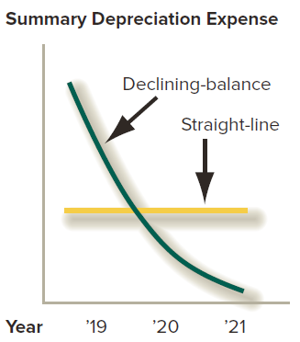
Depreciation methods – comparison
Source: Financial accounting, Libby, Libby and Hodge, 10th edition, McGraw-Hill Education

Slide 10
Impairment and sale of asset
Asset write-downs (impairment) – an expense to bring the asset value down to its market value. Potential earnings management:
Insufficient write-down
Too large write-down
Sale of an asset – proceeds relative to asset’s book value:
Gain on sale results in income taxes
Loss on sale results in tax credit

Slide 11
Goodwill and Intangible Assets

Slide 12
Intangible assets - overview
Intangible assets are long-term assets without physical substance.
Examples:
Goodwill
Trademarks, copyrights, patents
Technology
Content
Customer lists and relationships

Slide 13
M&A – Purchase Price Allocation
Premium agreed and paid
Premium paid – estimated synergies, other; could be zero or substantial
Purchase price paid by the acquirer
Net intangible assets
Fair value of the target = operating and non-operating tangible plus intangible assets net of operating and non-operating liabilities
Net tangible assets

Slide 14
M&A - Purchase Price Allocation
Premium agreed and paid
Goodwill:
The excess over the net identifiable tangible and intangible assets
It represents the premium plus those intangible assets that cannot be clearly identified and measured
Net intangible assets
Net identifiable tangible and intangible assets:
Assets and liabilities currently reported on the BS of the target prior to the acquisition
Intangible assets not recorded on the BS of the target, but easily identifiable
Net tangible assets

Slide 15
Accounting for goodwill
Goodwill arises only from acquisitions.
Value - the difference between the purchase price and the fair value of all net identifiable assets.
Goodwill is usually treated as having an infinite life, so it is not amortized.
It is tested for impairment and any write-downs are recorded in earnings.

Slide 16
Accounting for intangible assets
Most are reported after an acquisition.
The cost of internally developed intangible assets is expensed as incurred.
Value – the price paid by the acquirer.
Regular expense:
Those with finite life are amortized over this finite life.
Those with infinite life are tested for impairment.

